Slide 1
LSTMs
Learning to forget
Devansh Kukreja and Eric Nie

Slide 2
Background/Motivation
State-of-the-art in sequence learning
Address the issue of remembering information
Useful for analyzing sequential data
Cells within RNNs and LSTMs maintain an internal state

Slide 3
Recurrent Neural Networks (A Brief Introduction)

Slide 4

Intro
Recurrent Neural Networks
Internal states
Sequences of inputs and outputs
Share weights across timesteps
Notes:
Describe the basics of how a recurrent neural network functions

Slide 5

More RNNs
https://karpathy.github.io/2015/05/21/rnn-effectiveness/

Slide 6
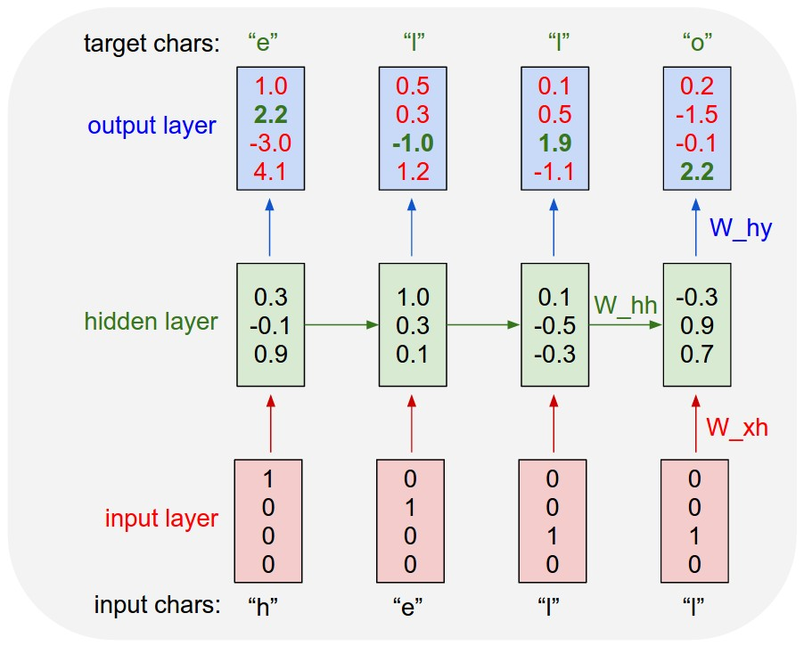
Character-level RNN
Predict the next character given input
One-hot encoding
https://karpathy.github.io/2015/05/21/rnn-effectiveness/
Notes:
One hot encoding of the characters into an array

Slide 7
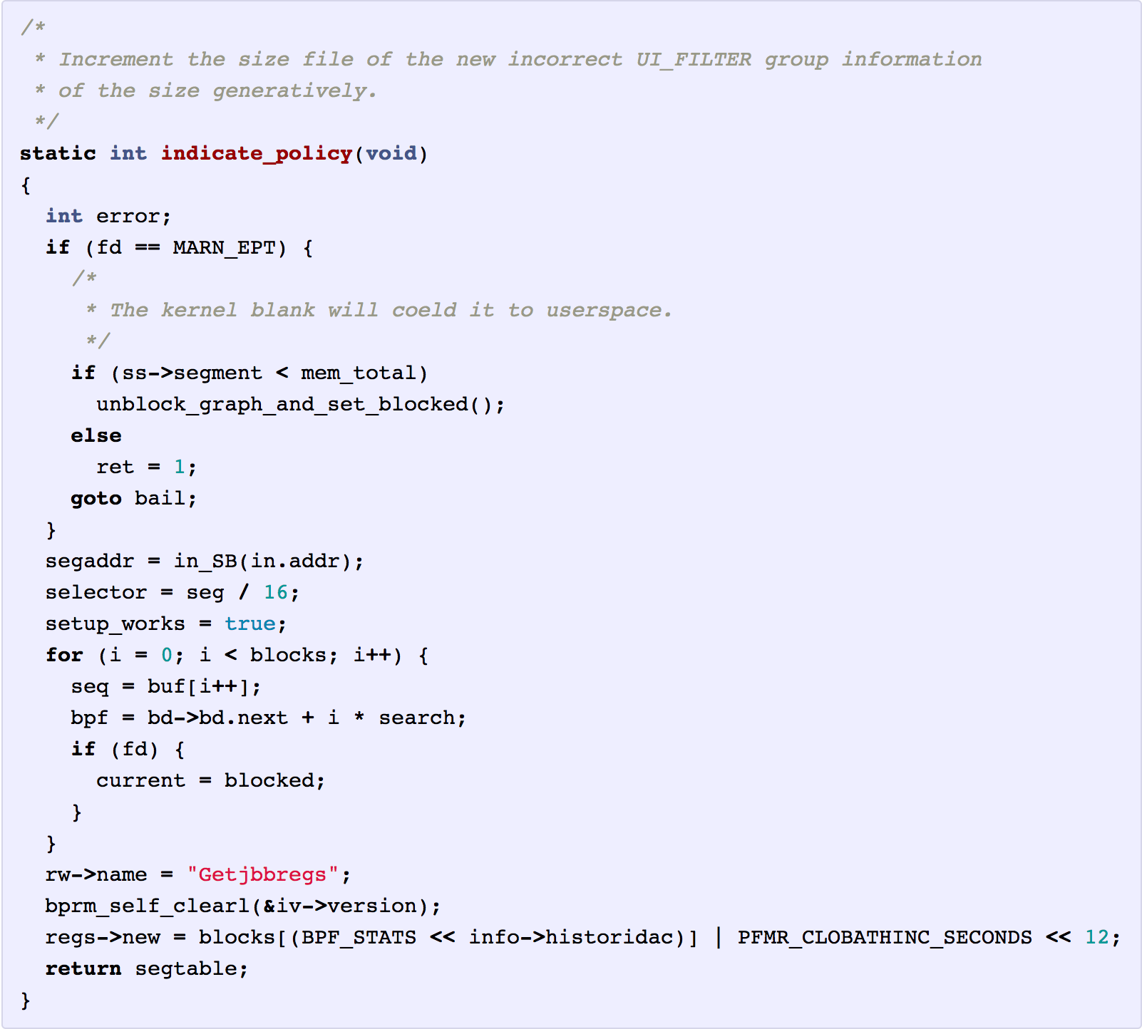
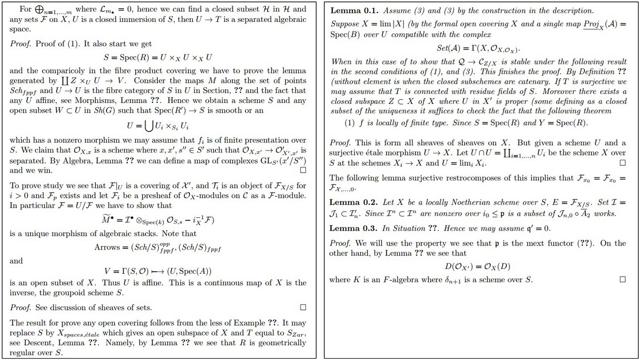
What can an RNN do?
Generate Text: Linux source code
Produce Research Papers:

Slide 8
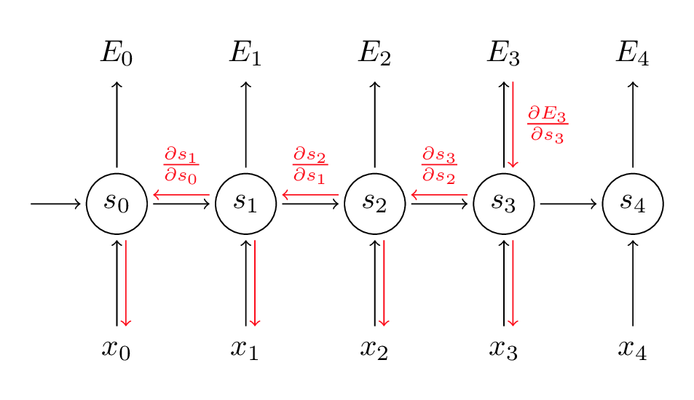
Training a RNN
Backpropagation through time:
Minibatches of subsequences
Update weights after some number of inputs

Slide 9
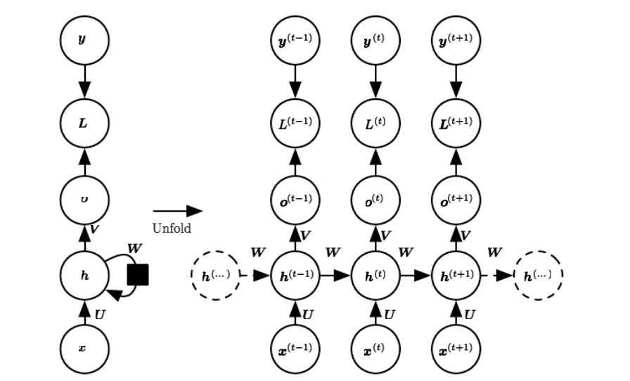
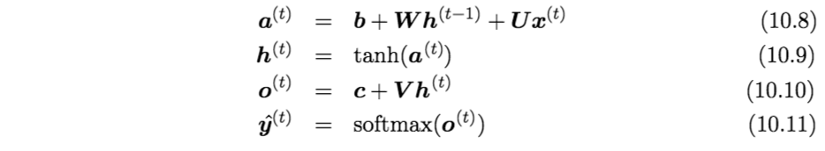
Equations for forward pass

Slide 10
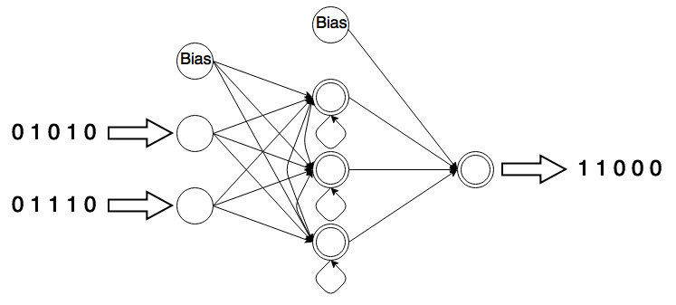
Adding Binary Numbers
Notes:
Generalize better

Slide 11
Issues with RNNs
Training RNNs uses backpropagation through time
Exploding and vanishing gradient problem similar to that of deep neural networks

Slide 12
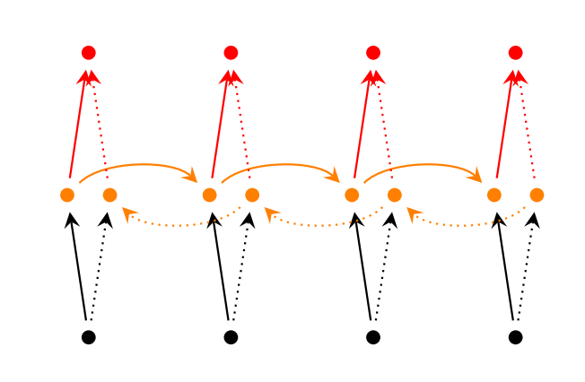
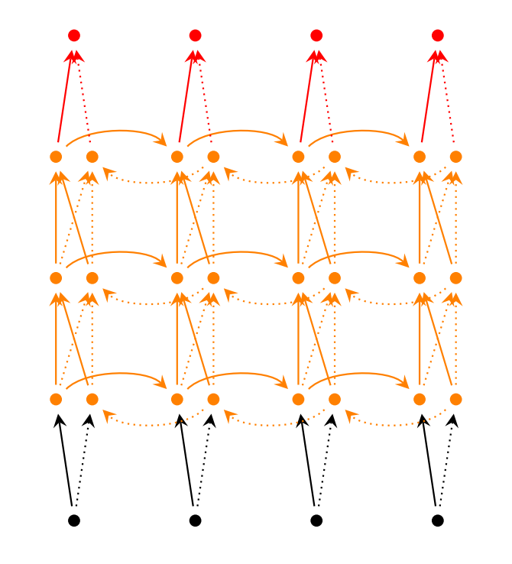
Extension to RNNs
Bidirectional RNNs
Deep Bidirectional RNNs

Slide 13
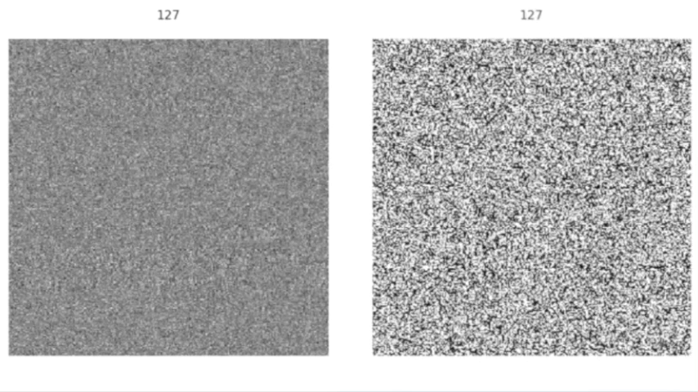
Final Word on RNNs
Turing complete
Useful for learning sequential data
Trouble capturing long-term dependencies in practice

Slide 14
LSTMs are a variant RNN that uses “gating units” to control information flow adaptively to combat “gradient vanishing” *
* Pulled from a whiteboard; likely written by a CMU Grad Student.
Notes:
This is where LSTMs come in.
LSTM stands for Long Short Term Memory, and it’s a variant on RNN that uses “gating units” to control information flow adaptively to combat “gradient vanishing”

Slide 15
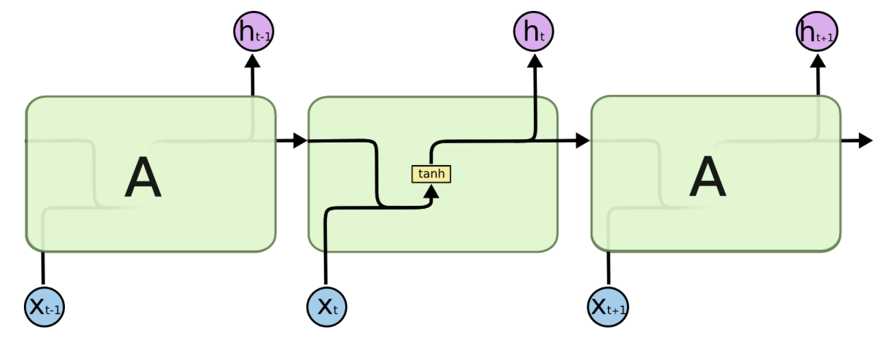
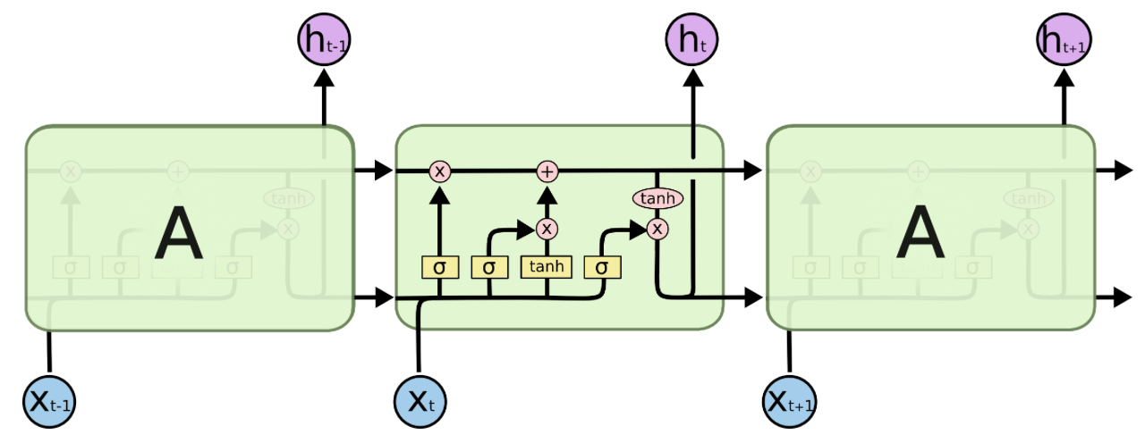
Long Short Term Memory Networks
http://colah.github.io/posts/2015-08-Understanding-LSTMs/
Notes:
Here we have a standard RNN that’s been slightly unrolled. We see we have two inputs and two outputs. RNNs tend to have a pretty simple structure like a single tanh neural layer. When we diagram an LSTM the same way, things get a little more complicated. We now have three inputs and three outputs. Instead of a single layer, we have 4.
The core idea is the cell state,

Slide 16
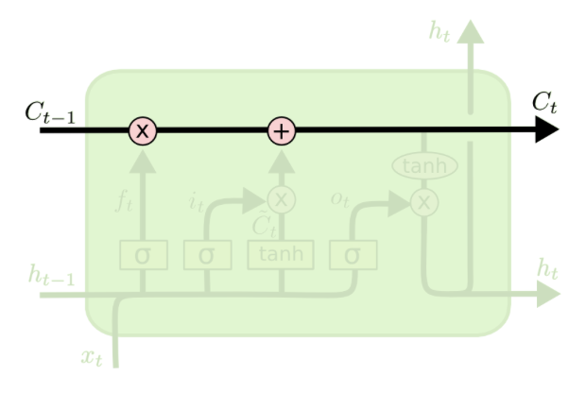
Long Short Term Memory Networks
http://colah.github.io/posts/2015-08-Understanding-LSTMs/
Notes:
which is this line running across the top. The idea is to protect and control the cell state to carefully regulate what information is remembered and what information is added. To do that, we use three gates.

Slide 17
Long Short Term Memory Networks
Forget Gate
Input Gate
Output Gate
http://colah.github.io/posts/2015-08-Understanding-LSTMs/
Notes:
A standard LSTM has 3 gates, each modelled with a sigmoid layer that multiplies a matrix, controlling the amount of information that passes through it. We have the forget gate, this one here; the input gate, and the output gate

Slide 18

Forget Gate
Takes in h_{t-1} concat x_{t} and outputs a number between 0 and 1 for each number in the cell state.
That output filters the cell state, selectively choosing how much of each node to forget.
http://colah.github.io/posts/2015-08-Understanding-LSTMs/
Notes:
So the forget gate decides what information to ‘forget’ from the previous cell state.

Slide 19

Input Gate
Sigmoid Input gate decides what new information can flow in.
Tanh layer creates a vector of new candidate values that could be added.
http://colah.github.io/posts/2015-08-Understanding-LSTMs/

Slide 20

Putting it together
Apply forget gate
Compute new candidate cell state
Filter in new cell state
http://colah.github.io/posts/2015-08-Understanding-LSTMs/

Slide 21

Output Gate
Run new cell state through tanh to put values between -1 and 1.
Multiply it by the output of the third sigmoid gate to decide what to output.
http://colah.github.io/posts/2015-08-Understanding-LSTMs/

Slide 22
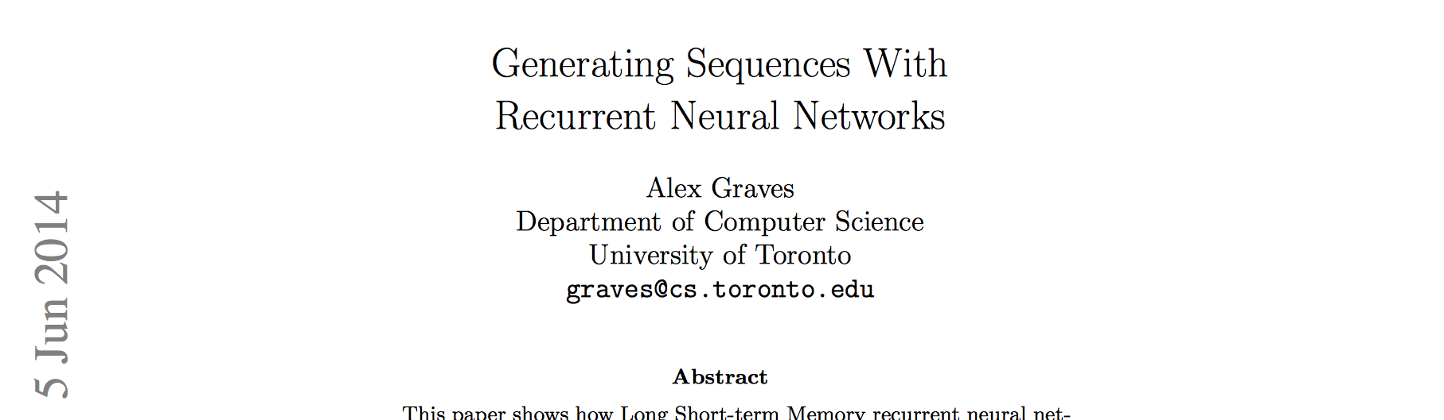
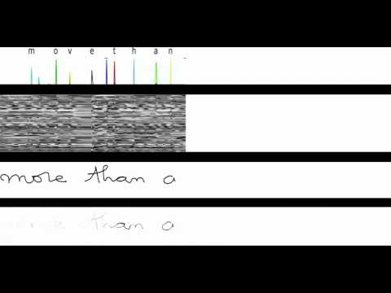
LSTM Demo
Row 1: Characters as they’re recognized
Row 2: States of some memory cells
Row 3: Writing as it’s analyzed
Row 4: Gradient backpropagated to inputs from the most active character
https://arxiv.org/pdf/1308.0850.pdf

Slide 23
Variations on LSTM

Slide 24
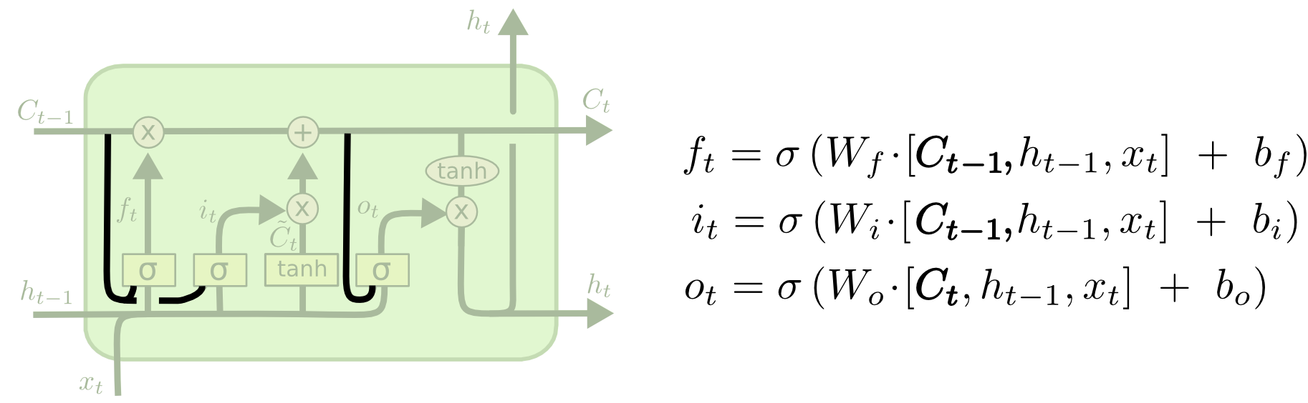
Peephole Connections
Pass the gate layers the current cell state.
Helps the system learn from the size of the time lags.
ftp://ftp.idsia.ch/pub/juergen/TimeCount-IJCNN2000.pdf
http://colah.github.io/posts/2015-08-Understanding-LSTMs/

Slide 25
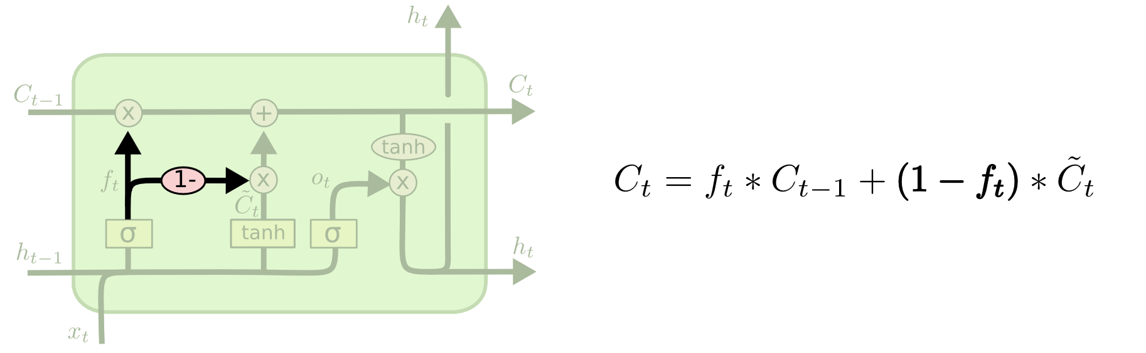
Couple Forget/Input Gates
Pass the gate layers the current cell state.
Simplifies the cell but reduced performance slightly.
http://colah.github.io/posts/2015-08-Understanding-LSTMs/

Slide 26

Gated Recurrent Unit (GRU)
Combine forget and input gates into an “update gate”
In general, equal to LSTMs in performance and faster in training
http://colah.github.io/posts/2015-08-Understanding-LSTMs/

Slide 27
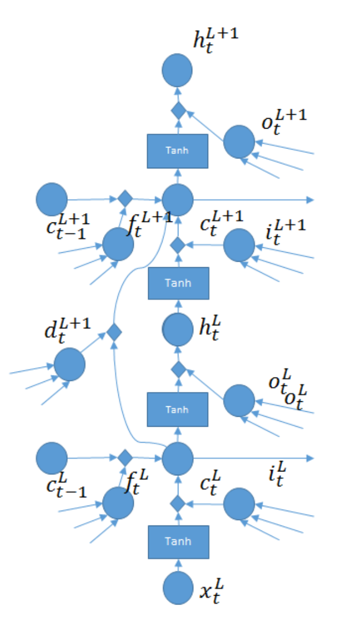
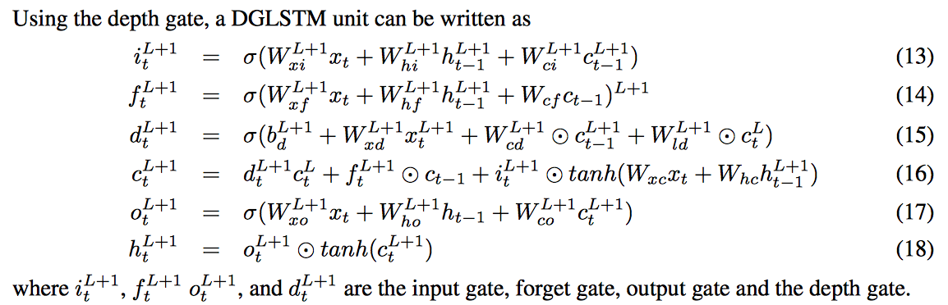
Depth Gated RNNs
Adds a fourth gate - the Depth Gate
Creates a gated linear connection between lower and upper layer memory cells
Relates to highway networks and Grid LSTM

Slide 28
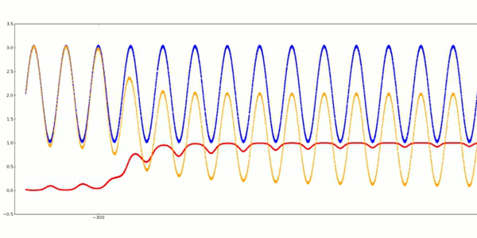
Questions
Eric Nie
Devansh Kukreja
LSTMs
LSTM learning to predict next noised sinus value.
Training Signal
LSTM Prediction
Error

